Slide 3
Everything has changed
Much remains unchanged
Some practices
Some outcomes
God, Humanity, Universe, Basic Needs

Slide 4
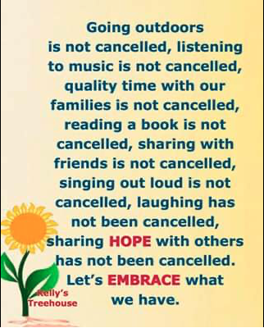
Everything has changed
Much remains unchanged
Some practices
Some outcomes
God, Humanity, Universe, Basic Needs

Slide 5
UNCERTAINTY
. Health and
Well-being
. Business and
Finance
. Church and
Outreach

Slide 6
FEAR or FAITH Response ?

Slide 7
BAD FEAR
Unreasonable
Destructive

Slide 8
GOOD FEAR
Reasonable
Protective

Slide 9
FAITH
Not believing in the absence of trouble
[JOHN 16:33]

Slide 10
FAITH
Asking for protection,
help ….
[MATTHEW 6:11-13]

Slide 11
FAITH
Trusting God when things do not go our way
[2 CORINTHIANS 12:8-9]

Slide 12
FAITH
Willing to accept God’s will when it is different from ours
[MATTHEW 26:36-42]

Slide 13
FAITH
Trusts that there is a bigger picture in play
[ROMANS 8:26-29]

Slide 14
FAITH
Continuing to be the people of God ministering to one another and to the world
[PHILIPPIANS 1:12-14; 2 CORINTHIANS 8:1-4]

Slide 15
MINISTERING INTERNALLY
Check in on one-another by phone and messaging Become part of a team to deliberately check in on the ‘at risk’ people self-isolating
Use the RCC Facebook Group as a way of minimizing social isolation and to encourage each other.
Respond practically to known need

Slide 16
MINISTERING EXTERNALLY
Offer to help your neighbours

Slide 17
MINISTERING EXTERNALLY
Offer to help your neighbours
Sharing your stuff
I just fluked it for 24 rolls of three ply at Aldi. If anyone is in need, I am happy to share.

Slide 18
MINISTERING EXTERNALLY
Offer to help your neighbours
Share your stuff
Protect the community by following advised health protocols
Testify to how God is helping you deal with the uncertainty you face

Slide 19
MINISTERING EXTERNALLY
Most of our brethren were unsparing in their exceeding love and brotherly kindness. They held fast to each other and visited the sick fearlessly, and ministered to them continually, serving them in Christ. And they died with them most joyfully, taking the affliction of others, and drawing the sickness from their neighbours to themselves and willingly receiving their pains. And many who cared for the sick and gave strength to others died themselves having transferred to themselves their death.
Eusebius, Ecclesiastical History VII.22.7. citing a letter from Bishop Dionysius of Alexandria (c.200-264)

Slide 20
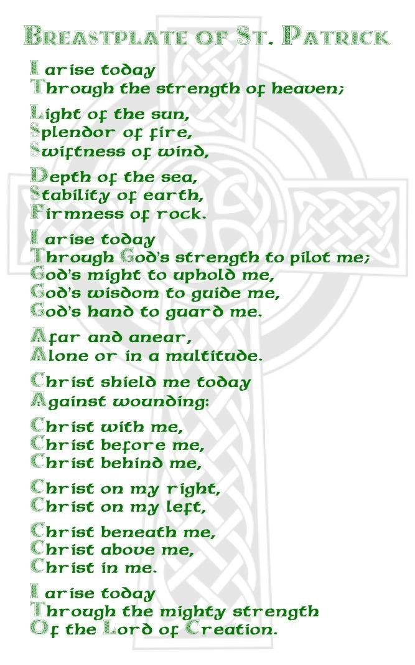
We can do this in the power of the Spirit of Christ.

Slide 21
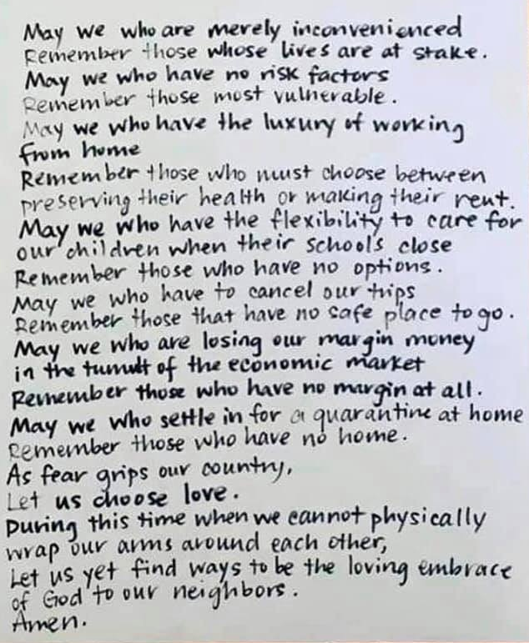
PRAYER for a PANDEMIC author unknown

